Slide 1

JSON Standards
Jamie Lennox
jamielennox@gmail.com
@jamielennox_
Notes:
Prep:
Have browser open to the alpaca demo
Have vim open to the resume.json
Do :Vison resume.json to preload vison.
Welcome everyone, my name is Jamie Lennox, I'm a senior software engineer at red hat, and because I'm pretty sure I'm pressed for time in this talk we're going to get straight underway.

Slide 2

Source: http://xkcd.com/927/
Notes:
When I first proposed this talk I knew this picture would be in it, so I'm going to get it out of the way early.
I would like to start out with a few disclaimers. There are hundreds of standards or helper libraries or best practices who's aim is to make it easier to develop better quality REST interfaces.
There are whole genres I'm not even going to try and cover. My goal here is to provide an introduction to a few of the standards I know or have worked with and encourage you when developing a new API or extending an existing one to reach out to see what has already been developed.
There are also a lot of competitors to the standards I have chosen, some of them are better known or more mature and may work much better for you. I don't mind what you use, but I encourage you to research first.
I'm not going to give a REST overview or anything like that, I'm pretty sure almost everyone here should know that stuff already.
The facts I give I believe to be accurate, but there is little consensus on the best way to REST, or consensus on how you should best write your APIs. So everything beyond simply explaning the protocols is my own opinion.
Not like whether these are views reflect the views of my employer, like the people who spend their days debating API design on forums or twitter will disagree with most of what I say - and they're probably right.
I care a lot about good web and REST design but I'm really happy to let other people argue over standards. Above all I want standards so I can be productive, I want tooling that helps me work and I don't want to start from scratch with every API.
Given that we are at PyCON throughout the talk I'll at least mention the python support or the available libraries but in general we're going to be looking at the APIs rather than the libraries.
Also depending on the age of the schedule you're reading you might see mention of the json web tokens and json encryption standards. We're not going to mention that at all as I'm going to run out of time with what I've already got and they are really a talk on their own. As it is we are going to rush through, my hope is that you will gleem enough information to know if each standard is right for your case and investigate futrher yourself.

Slide 3
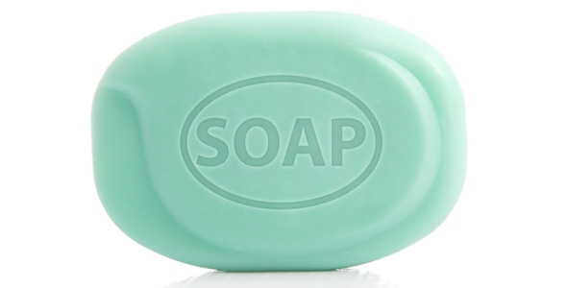
Notes:
So the first real web service I ever wrote used SOAP. REST was around but even less poorly understood than it is today and SOAP was in its hayday.
For those of you who haven't seen it soap is an XML based request system that was extended out of XML-RPC. The SOAP protocol isn't pretty. It's enterprise-y, is maintained by a committee and it spins together all of the nifty tricks of XML. Initially the S stood for Simple but they officially dropped the acronym so that it no longer means anything in particular.
But SOAP was popular for a reason. It was really well supported by all the languages and SOAP interfaces came with a WSDL file that was a detailed description of all the functions that interface accepted including some documentation all the parameters and return types and the errors that might occur.
So the reason I used SOAP for that first web service was because I could quickly construct the functions I needed in PHP. I Autogenerate and publish the WSDL file that described the entire interface and from there I could have visual studio generate code that completely implemented the interface. I'm not necessarily proud of my language choices but by following a couple of fairly simple tutorials I had a complete web service.
And in all reality so long as my requests were being correctly received and handled by the web server – why do I care what the protocol looks like?

Slide 4
jsonrpc ~= xmlrpc
jsonpath ~= xpath
jsont ~= xslt
Notes:
And people had learnt to work with XML. There are still really powerful tools for XML that don't exist for JSON. So as JSON got popular a lot of those old standards tried to be updated into the more modern era.
JSONRPC has most of the same advantages as XML-RPC or SOAP. Well defined calling conventions and error handling and auto generation of interfaces.
Xpath is pretty effective, though it's very existence shows some of the problems of working with xml. Jsonpath is interesting and seems to work well but there is really less need for it when working in JSON.
Xslt is incredibly power and horrendous to use, jsont isn't exactly a peach either but it looks somewhat like a jinja template.

Slide 5
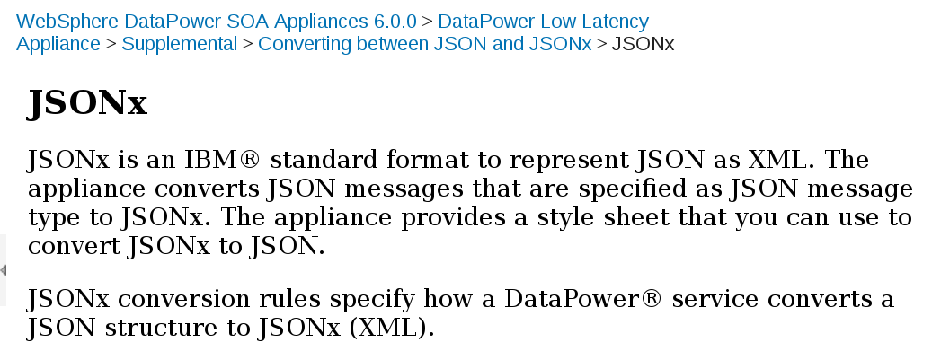
Source: http://www-01.ibm.com/support/knowledgecenter/SS9H2Y_6.0.0/com.ibm.dp.xm.doc/json_jsonx.html
Notes:
This evolution of old technologies was taken too far as if we could just port that pesky JSON back into XML we could keep using all these tools that have worked in the past.
It's also another reminder than it's really easy to apply the word standard to your project.

Slide 6
JsonML.org
JsonML (JSON Markup Language) is an application of the JSON (JavaScript Object Notation) format. The purpose of JsonML is to provide a compact format for transporting XML-based markup as JSON which allows it to be losslessly converted back to its original form.
Native XML/XHTML doesn't sit well embedded in JavaScript. When XHTML is stored in script it must be properly encoded as an opaque string. JsonML allows easy manipulation of the markup in script before completely rehydrating back to the original form.
Notes:
And just in case you thought that was a dumb idea the opposite exists as well, a standard way to represent XML as JSON.

Slide 7
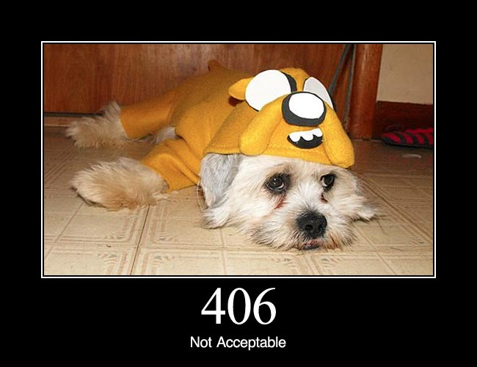
Source: http://httpstatusdogs.com/406-not-acceptable
Notes:
I don't mean to criticise those efforts too much. It's not too difficult to come up with valid reasons to do all of those things.
The reality is simply that JSON is not XML and those same tools won't apply in the same way.
But the goals of those SOAP interfaces are still valid and they are actually very similar to the some of the goals expressed by REST.
We want stateless requests, it just scales better.
We want language and protocol independence.
We want open standards so as nott to be tied to a specific company or supplier.
These things are basics of the web that are essentially a given.
We want to be able to discover an API and learn how to use it from the API itself. If you look at the original REST thesis this is a part of what he termed "Hypermedia as the Engine of Application State" or HATEOAS. I don't know if that's the official pronunciation. It doesn't matter it's mostly refereed to as hypertext.
In it's simplest form most implementations of hypertext involving linking throughout an API so that hyperlinks are delivered as part of the body, from a single interface you can find links to all available resources, and from a resource you can follow links to actions related to that resource and the mime-types tell you how the information there will be portrayed.

Slide 8
jsonhome
{
"resources": {
"http://example.org/rel/widgets": {
"href": "/widgets/",
"hints": { ... }
},
"http://example.org/rel/widget": {
"href-template": "/widgets/{widget_id}",
"href-vars": {
"widget_id": "http://example.org/param/widget"
},
"hints": { ... }
}
}
}
pip install jsonhome
Notes:
So moving on from the philosophy, and on to some of what's out there to help with these goals.
The first cab up is jsonhome which provides a full list of all the resources that should be exposed over by your API and how they should be accessed. A very direct implementation of the ability to discover all available resources.
The document is a resources object that exposes all the relations that are present in the api. Each relation is unique so that a client can find the relation that it is looking for.
Each resource then contains either a href field or a href-template and href-vars field. Href is a direct link to the resources that you are looking for. Href template provides a template from which to build urls and specifies the variables that are required to build the url.
The example shows to list all widgets you go to /widgets to get a specific widget you go to /widgets/widget_id and clearly identifies what type of value widget_id is.
With that combination you could theoretically rearrange your entire API and a conforming client would continue to put the widget_id in the templated spot and continue working.

Slide 9
uritemplate
http://example.com/~{username}/
http://www.example.com/foo{?query,number}
http://www.example.com/foo{?value*}
https://{mirror}/packages/source/{package:1}/{package}/{package}-{version}.tar.gz{#md5}
rfc6570
pip install uritemplate
Notes:
As a bit of an early side track the format of that href template field is well defined in a very useful RFC, which deserves mentioning even though it's not JSON.
The curly braces define a location where a variable can be replaced into the string to construct a URI.
The first example shows where a username should be inserted to access a user's information.
By putting the query string inside the braces the second says that the foo route takes an optional query and/or number parameter, and if both are present do the standard ampersand join for query strings.
The third accepts any number of value= query parameters.
But there is much further you can go with this concept. The last example is the uri for downloading a source package from pypi. The mirror is the source, packages are in folders seperated by the first letter of the package name, the package, then package dash version .tar.gz possibly with the md5 sum as a fragment.
So there is a lot of flexibility with what you can express with uritemplate and I recommend you use it if you need to do links.

Slide 10
jsonhome
"resources": {
"http://example.org/rel/widget": {
"href-template": "/widgets/{widget_id}",
"href-vars": {
"widget_id": "http://example.org/param/widget"
},
"hints": {
"allow": ["GET", "PUT", "DELETE", "PATCH"],
"formats": {
"application/json": {}
},
"accept-patch": ["application/json-patch"],
"accept-post": ["application/xml"],
"accept-ranges": ["bytes"]
}
}
}
pip install jsonhome
Notes:
Back to json home in addition to the URI we have hints that tell you how to hit the URI. We can see in the example here we specify what methods are accepted, what formats you can request and what mime-types are accepted in a post or patch.
There are a number of additional hints that are predefined and you are allowed to define your own if you feel you must.
With this layout you can provide to a client a completely discoverable way to move through your API.
There jsonhome library gives basic support for constructing and querying jsonhome documents but there are no automatic builders hooking into like django or flask.

Slide 11
JSON Schema
JSON Schema ~= xsd (xml schema)
{
"type": "string",
"minLength": 10,
"maxLength": 14,
"pattern": "^\D*0(\D*\d){9}\D*$"
}
{
"type": "boolean"
}
{
"type": "number",
"multipleOf": 10,
"minimum": 0,
"maximum": 100
}
{
"type": "string",
"enum": ["red", "green"]
}
pip install jsonschema
Notes:
So JSON home tells you all the URIs available via an API and REST purests will tell you that because each resource has a well defined mime type you should know the accept and return content type for all those resources. In reality a lot of APIs just define accepting JSON.
JSON Schema then specifies a contract for the JSON data required by a URI. So where jsonhome was describing the URIs themselves JSON schema strictly defines what is acceptable as the body of a request.
I have some basic examples up here to start with that try and illustrate the features of the types. So a json schema is simply a JSON object with a type value and some additional type specific restrictions.

Slide 12
JSON Schema
{
"type": "array",
"items": {
"type": "number",
"maximum": 50
},
"minItems": 3,
}
{
"type": "array",
"items": [
{
"type": "number",
"minimum": 1,
"multipleOf": 1
},
{
"type": "string"
},
{
"type": "string",
"enum": ["Street",
"Avenue",
"Boulevard"]
}
],
"additionalItems": false
}
Notes:
Where json schema gets interesting is when we start building complex objects.

Slide 13
JSON Schema
{
"type": "object",
"properties": {
"name": {
"type": "string"
},
"phone": {
"type": "string"
},
"age": {
"type": "number",
"minimum": 5
}
},
"additionalProperties": false,
"required": ["name"]
}
{
"name": "Trevor",
"age": 44
}
{
"age": 44
}
{
"name": "Trevor",
"legSeam": 81
}

Slide 14
JSON Schema
{
"definitions": {
"address": {
"type": "object"
"properties": {
"street_address": {"type": "string"},
"city": {"type": "string"},
"state": {"type": "string"},
},
"required": ["street_address", "city", "state"]
}
}
"type": "object",
"properties": {
"billing": { "$ref": "#/definitions/address" },
"shipping": { "$ref": "#/definitions/address" }
}
}
Notes:
Once we start gettting more complex documents we can start defining reusable schemas that can be reused, rather than repeat definitions

Slide 15
JSON Schema
{
"anyOf": [
{"type": "string"},
{"type": "number"}
]
}
{
"not": {
"type": "string"
}
}
{
"shipping": {
"allOf": [
{"$ref": "#/definitions/address"},
{
"properties": {
"address_type": {
"enum": ["residential", "business"]
}
}
}
]
}
}
Notes:
Then there are ways of combining definitions, so in the first case we have an entry which could be either a string or a number field, or anything but a string.
The last one is an example of inheritance. By defining the field is allOf a number of definitions we can say that it must validate as a valid address but also validate with an address_type as an enum, so we can make some really rich schemas to define our request or response body.
But why, we could have easily done this in code.
The first advantage I see is using code as documentation. You can and should publish this schema so that anyone using your API knows exactly what will be accepted.
Secondly this is where things get interesting with our tooling as it's possible for our environment to start helping out with development.
For example – SHOW VIM AND ALPACA

Slide 16
Robustness Principal
“Be conservative in what you send, be liberal in what you accept”
Jon Postel – RFC 1122 – Oct 1989
Notes:
So this feels like a good time to mention this.
You've probably seen the phrase here even if you didn't know what to call it.
"Be conservative in what you send, be liberal in what you accept"
This RFC 1122 is also the first accepted IP document, but a similar statement is in drafts from the years before as well.
It sounds good right, when you're writing a client you should obey the protocol as strictly as possible, but when you're writing a server you should do the right thing as much as possible, even if there are some errors.

Slide 17
The Harmful Consequences of Postel's Maxim
https://tools.ietf.org/html/draft-thomson-postel-was-wrong-00
Can lead to interoperable implementations
Flaws become standards
Backwards compatibility
“Protocol designs and implementations should be maximally strict.”
Fail Fast and Hard
Notes:
It is however time to let that one go.
This site that is linked is by no means the first one to criticise this phrase, however I like this one a lot as he submitted it as a draft to the ietf.
When you allow these differences in a standard then you end up with drift as these small changes in implementation become relied and eventually you end up standardizing all the small flaws in the implementation just to get things working again.
When you are just doing your own API it's a pain for managaing backwards compatibility as if you start modifying the code you may still be doing the right thing according to your documented interface, but some client is relying on returning exactly the same dictionary, like the difference between returning a dictionary with a key with a None value versus not having the key in the dictionary. Or some parameter that used to be ignored on POST but is all of a sudden validated, having not defined behaviour is going to break people.
Anything that you doesn't comply completely with what you expect should raise an error. Adding new functionality to what used to be an error is completely safe. No one relies on your error behaviour.
Fail fast, fail hard.

Slide 18
>>> import jsl
>>> class Entry(jsl.Document):
... name = jsl.StringField(required=True)
...
>>> class File(Entry):
... content = jsl.StringField(required=True)
...
>>> class Directory(Entry):
... content = jsl.ArrayField(jsl.OneOfField([
... jsl.DocumentField(File, as_ref=True),
... jsl.DocumentField(jsl.RECURSIVE_REFERENCE_CONSTANT)
... ]), required=True)
...
>>> Directory.get_schema()
pip install jsl
Notes:
Coming back to the technology there are a bunch of libraries that can be used to generate jsonschema documents if you don't want to write them by hand.
JSL is good as an example because it's framework agnostic and you can fairly easily see the mapping from python code to jsonschema.
If you are using a framework like django or flask though there are frameworks that tie directly into the models you define so probably use those.

Slide 19
>>> schema = {
'name': 'Country',
'properties': {
'name': {'type': 'string'},
'abbreviation': {'type': 'string'},
'population': {'type': 'integer'},
},
'additionalProperties': False,
}
>>> import warlock
>>> Country = warlock.model_factory(schema)
>>> sweden = Country(name='Sweden', abbreviation='SE')
>>> sweden.name = 5
Traceback (most recent call last):
File "<stdin>", line 1, in <module>
File "warlock/core.py", line 53, in __setattr__
raise InvalidOperation(msg)
warlock.core.InvalidOperation: Unable to set 'name' to '5'
pip install warlock
Notes:
Similarly from the client side you can take an existing jsonschema and create self validating classes out of it.
And I show this one because with server and client side we're almost to the point where SOAP was a decade ago. This is python, generating code doesn't make sense when you can dynamically construct classes.
Attributes are validated at assignment time.
At the end you have an object you know will pass validation when submitted to the server.
Again there are a couple of libraries that do something similar to this, one of the things I like about warlock though it that it can generate jsonpatch documents.

Slide 20
jsonpatch
{
"baz": "qux",
"foo": "bar"
}
[
{ "op": "replace", "path": "/baz", "value": "boo" },
{ "op": "add", "path": "/hello", "value": ["world"] },
{ "op": "remove", "path": "/foo"}
]
{
"baz": "boo",
"hello": ["world"]
}
Before:
Patch:
After:
rfc6902
pip install jsonpatch
Notes:
Lets you do a transaction log of changes to an object.
Operations: Add, remove, replace, copy, move, test (which is like assert).
For anyone that's done much with databases there are some familiar concepts in that we can keep write only logs of how an object is to change, it simplifies merges, and we can store these patches with the user who submitted them for full audit tracking.
The path element is in a format called jsonpointer which is rfc6901 (one before this one).
Python Library lets you do a diff between python dicts or apply a patch set to an existing dict.

Slide 21
json hyper-schema
{
"title": "Article",
"type": "object",
"properties": {
"id": { ... },
"title": { ... },
"authorId": { ... },
},
"required" : ["id", "title", "authorId"],
"links": [
{
"rel": "author",
"href": "/user?id={authorId}"
"targetSchema": { ... }
},
{
"rel": "alternate",
"href": "/{id}/rss",
"mediaType": "application/rss+xml"
}
]
}
Notes:
Now rather than have to have two seperate standards for hypertext and schema there is an extension to the json schema standard called json hyper-schema.
This is a completely optional additon to the basic json schema structure so the schema can be used as normal to validate a json struture but adds links to attempt to make it more HATEOAS. This is an interesting idea keeping the links in the meta-data, or the schema because in general these values aren't going to change per resource, however it lacks a way to provide a lot of the information jsonhome can and hasn't taken off in the same way jsonschema alone has.

Slide 22
jsonapi
:(
jsonapi.org

Slide 23
Don't use everything
Try and use something
Don't take my word on anything
Notes:
To finish I hope you learnt something, even one standard you hadn't seen before.
Don't go overboard, there are hundreds of standards out there and it's going to end up a mess if you try and use all of them.
Conversely if you're doing an API have a look, see if there is something that fits your use case. The more we can adopt these existing standards, the better the tooling that will grow up around them and the easier it will be to create and work with your API. There are specialist APIs available for geographical work, for representing statistics for almost everything.
Finally, this presentation was all about some technologies I think are interesting, but I barely scratched the surface. I'm sure there are better methods out there and I'd love to see someone else present about them next year.

Slide 24
jamielennox@gmail.com
@jamielennox_

